Slide 1
The Server Architecture Behind Killzone Shadow Fall
Jorrit Rouwé
Lead Game Tech, Guerrilla Games

Slide 2
Overview
Hosting Choices
Server Architecture
Match Making
Zero Downtime
Updating Without Patching
How Telemetry Helped Fix Issues

Slide 3
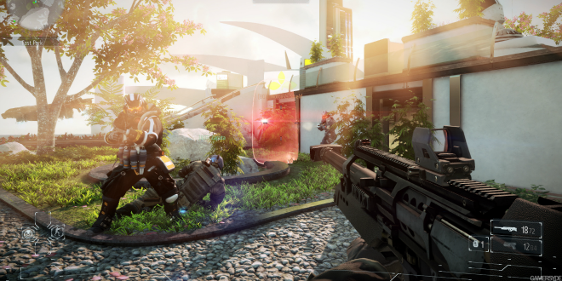
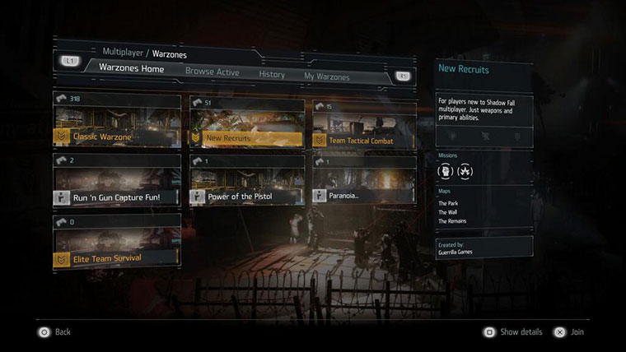
Introduction
Killzone Shadow Fall is a First Person Shooter
24 player team based gameplay
Warzone = Customizable Game
Selection of maps / missions / rules
Official and community created Warzones
Multiple active games in a Warzone
Bottom right screenshot shows 300+ players in 1 warzone

Slide 4
Hosting Choices

Slide 5
Hosting Choices - Need for Scaling
Killzone 3 used traditional hosting
Have to manage many environments
Adding / scaling environment needs planning
Shared load testing environment with other titles
Example environments: Guerrilla Internal, FPQA, FQA, Demo, Press, Production, Load Test

Slide 6
Hosting Choices - Need for Scaling (2)
For Killzone Shadow Fall we needed flexibility
Launch title = no Public Beta
Effect PlayStation®Plus pay wall?
Used Amazon for easy scaling
Load testing
100K sims
100 real players
Some servers still physically hosted in Sony data centers

Slide 7
Server Architecture

Slide 8
Server Architecture - Overview
Most components use standard web technology
Java
Tomcat
REST
Simpler hosting by using Amazon components
Storage: Dynamo DB / S3 / Redshift
Deployment: Cloud Formation / Elastic Beanstalk
Monitoring: Cloud Watch

Slide 9
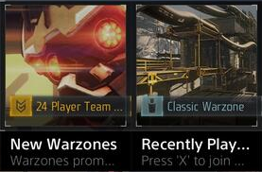
Server Architecture - Overview (2)
Dynamo DB
Regional:
Turbine clusters
Webapp
cluster
Create game
killzone.com
Load balancer
Announce
Matchmaking,
leaderboards,
warzones, …
Live Tiles
= HTTPS REST
Gameplay
= Hazelcast
= UDP
Game
Webapps are all running the same components
Turbine hosted partially in Sony data centers, partially in AWS
Hazelcast is peer to peer communication library

Slide 10
Server Architecture - Gameplay (Turbine)
Game 1
C++ / libRUDP
Messaging hub between players in a game
Game logic runs on the PS4TM
Advantages:
Prevents NAT issues
Reduces required bandwidth
Disadvantages:
We pay for bandwidth
Introduces extra hop
Player 1
…
Player N
broadcast
Turbine
Player 1
…
Player N
Game N
libRUDP is part of the PS4 SDK and provides reliable UDP communication

Slide 11
Match Making

Slide 12
Match Making - General Principles
Linear scaling
State stored in memory
Minimal communication between servers
Fault tolerant
All servers equal
Client repeats requests
Client sends match updates
One server not aware of games hosted on other server
Since state is stored in memory clients need to repeat requests to reconstruct state in case of server outage

Slide 13
Match Making - Algorithm
Load balancer
Webapp 1:
Warzone B
Webapp 2:
Warzone A,
partition 1
Webapp 3:
Warzone A,
partition 2
Warzone B is small
Warzone A is too big to be hosted by 1 server so is split up in 2 partitions

Slide 14
Match Making - Algorithm
Request ID X: Join
Warzone A
Load balancer
Webapp 1:
Warzone B
Webapp 2:
Warzone A,
partition 1
Webapp 3:
Warzone A,
partition 2
Client creates request with random ID X

Slide 15
Match Making - Algorithm
Request ID X: Join
Warzone A
Load balancer
random
Webapp 1:
Warzone B
Webapp 2:
Warzone A,
partition 1
Webapp 3:
Warzone A,
partition 2
Load balancer is Amazon ELB, so random forwarding

Slide 16
Match Making - Algorithm
Request ID X: Join
Warzone A
Load balancer
Shared map:
Who hosts what warzone
Webapp 1:
Warzone B
Webapp 2:
Warzone A,
partition 1
Webapp 3:
Warzone A,
partition 2
Using shared Hazelcast map

Slide 17
Match Making - Algorithm
Request ID X: Join
Warzone A
Load balancer
In memory:
Pending request
Forward: Warzone A,
partition consistent_hash(X)
Webapp 1:
Warzone B
Webapp 2:
Warzone A,
partition 1
Webapp 3:
Warzone A,
partition 2
Lets say match was not found first time, so webapp 2 returns match making progress status

Slide 18
Match Making - Algorithm
Repeat Request ID X:
Join Warzone A
Load balancer
In memory:
Pending request
Forward
Webapp 1:
Warzone B
Webapp 2:
Warzone A,
partition 1
Webapp 3:
Warzone A,
partition 2
After 5 seconds client repeats request
Request has same ID so ends up on webapp 2 again

Slide 19
Match Making - Algorithm
Load balancer
Assign Game Y
Webapp 1:
Warzone B
Webapp 2:
Warzone A,
partition 1
Webapp 3:
Warzone A,
partition 2
Game found, assignment sent back

Slide 20
Match Making - Algorithm
Join Turbine
Load balancer
Webapp 1:
Warzone B
Webapp 2:
Warzone A,
partition 1
Webapp 3:
Warzone A,
partition 2
Game uses IP / port returned by game assignment to connect to Turbine

Slide 21
Match Making - Algorithm
Game Y, Warzone A:
Match Update
Load balancer
In memory:
players in Game Y
Forward: Warzone A,
partition consistent_hash(Y)
Webapp 1:
Warzone B
Webapp 2:
Warzone A,
partition 1
Webapp 3:
Warzone A,
partition 2
One client in game send match update when player joins (and periodically in 30 second intervals). Game can be hosted on different webapp because consistent_hash(Y) is used

Slide 22
Match Making - Algorithm
Load balancer
Webapp 1:
Warzone B
Webapp 2:
Warzone A,
partition 1
Webapp 3:
Warzone A,
partition 2
No Cross Partition Matching
Max partition size around 10K players
Requests only match with games on same partition
Requests can create new game on different node

Slide 23
Match Making - Finding Game
Greedy algorithm for finding best game
Weighted scoring, in priority order:
Region based on ping
Good / bad ping players
Biggest games first
Long unbalanced first
ELO Glicko skill
Don’t join game you just left
Ping all data centers on application startup
Match outside closest region after period of time
Good ping < 100 ms

Slide 24
Match Making - Round End
Merge small game into large
Put players back into own region
Balance team sizes
Balance skill
Take best 1 or 2 players from 1 team and exchange for worst players on other team

Slide 25
Zero Downtime

Slide 26
Zero Downtime - Overview
Killzone 3 often had hour long maintenance
Zero downtime deployment / scaling
Manage our own deployments
Being on call 24/7 makes us want to fix issues!
Every service redundant
So far only 2 outages (< 1 hr) due to our servers failing
Survived multiple ‘cable pulls’

Slide 27
Zero Downtime Deployment - Webapp
Turbine
Game
DNS lookup
Load
balancer
Webapp
Production environment
DynamoDB

Slide 28
Zero Downtime Deployment - Webapp
Turbine
Game
DNS lookup
Load
balancer
Load
balancer
Webapp
Webapp
Production environment
Staging environment
DynamoDB
Use Amazon to create second server set
Database is shared
New server is backwards compatible with old server

Slide 29
Zero Downtime Deployment - Webapp
Turbine
Game
DNS lookup
Load
balancer
Load
balancer
Clone
Webapp
Webapp
Production environment
Staging environment
DynamoDB
Clone handles request on production environment and replicates the request to the staging environment (but ignores result). Clone warms caches / load balancer. Take care not to write 2x to database.

Slide 30
Zero Downtime Deployment - Webapp
Turbine
Game
QA
DNS lookup
DNS override
Load
balancer
Load
balancer
Clone
Webapp
Webapp
Production environment
Staging environment
DynamoDB
QA can now test the staging environment

Slide 31
Zero Downtime Deployment - Webapp
Turbine
Game
DNS lookup
Load
balancer
Load
balancer
Forward
Webapp
Webapp
Production environment
Staging environment
DynamoDB
Forward does not process request on production environment but only on staging environment

Slide 32
Zero Downtime Deployment - Webapp
Turbine
Game
DNS swap
Load
balancer
Load
balancer
Forward
Webapp
Webapp
Production environment
Staging environment
DynamoDB

Slide 33
Zero Downtime Deployment - Webapp
Wait 24h
Turbine
Game
DNS swap
Load
balancer
Load
balancer
Forward
Webapp
Webapp
Production environment
Staging environment
DynamoDB
Some ISP’s don’t care about DNS record expiry, so you need to wait for 24h

Slide 34
Zero Downtime Deployment - Webapp
Turbine
Game
DNS swap
Load
balancer
Webapp
Staging environment
DynamoDB
Delete old production environment

Slide 35
Zero Downtime Deployment - Turbine
Games A
Games B
Turbine 1
Turbine 2
announce
Load balancer

Slide 36
Zero Downtime Deployment - Turbine
Games A
Games B
Turbine 1
Turbine 2
maintenance
Load balancer
50% of machines put in ‘maintenance mode’
Maintenance mode allows current games to keep playing / new players can still join game

Slide 37
Zero Downtime Deployment - Turbine
Games A
Games B
round rollover
Turbine 1
Turbine 2
maintenance
Load balancer
On round rollover (after approx. 20 minutes) game is moved to new Turbine server

Slide 38
Zero Downtime Deployment - Turbine
Games A
Games B
Turbine 1
(new)
Turbine 2
announce
Load balancer
We can update turbine servers now

Slide 39
Zero Downtime Deployment - Turbine
Games A
Games B
Turbine 1
(new)
Turbine 2
announce
maintenance
Load balancer
Other 50% put in maintenance mode

Slide 40
Zero Downtime Deployment - Turbine
Games A
Games B
round rollover
Turbine 1
(new)
Turbine 2
announce
maintenance
Load balancer

Slide 41
Zero Downtime Deployment - Turbine
Games A
Games B
Turbine 1
(new)
Turbine 2
(new)
announce
Load balancer

Slide 42
Zero Downtime Deployment - Turbine
Games A
Games B
round rollover
Turbine 1
(new)
Turbine 2
(new)
announce
Load balancer

Slide 43
Zero Downtime Deployment - Turbine
Games A
Games B
round rollover
Turbine 1
(new)
Turbine 2
(new)
announce
Load balancer
Do A/B testing!
Updating 1 server first and let it run for a couple of days
Check telemetry results / crashes to validate behavior because validating in QA is difficult due to amount of testers needed

Slide 44
Update Without Patching

Slide 45
Update Without Patching
Patch release cycle very long
1 week for emergency patches
4+ weeks for normal fixes
Developed server side tweaks system
Patching gameplay settings (e.g. weapon stats)
Adding collision volumes
Changes versioned, each game round uses specific version
Update to latest version on round rollover
Fixed 50+ exploits!
Server tweak is simple key / value pair
Using special notation to patch game settings e.g. (ClassName)ObjectName.AttributeName = Value

Slide 46
How Telemetry Helped Fix Issues

Slide 47
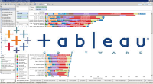
Telemetry
Can drill down to individual user for complaints
Visualization
Events
Plain text
Aggregation
Game
Collector
S3
Hive
Redshift
Tableau
Webapp
Very Powerful!
Example ‘Player Spawn’ + ‘Player Die’ event gets aggregated by Hive to ‘Player Life’ table in Redshift

Slide 48
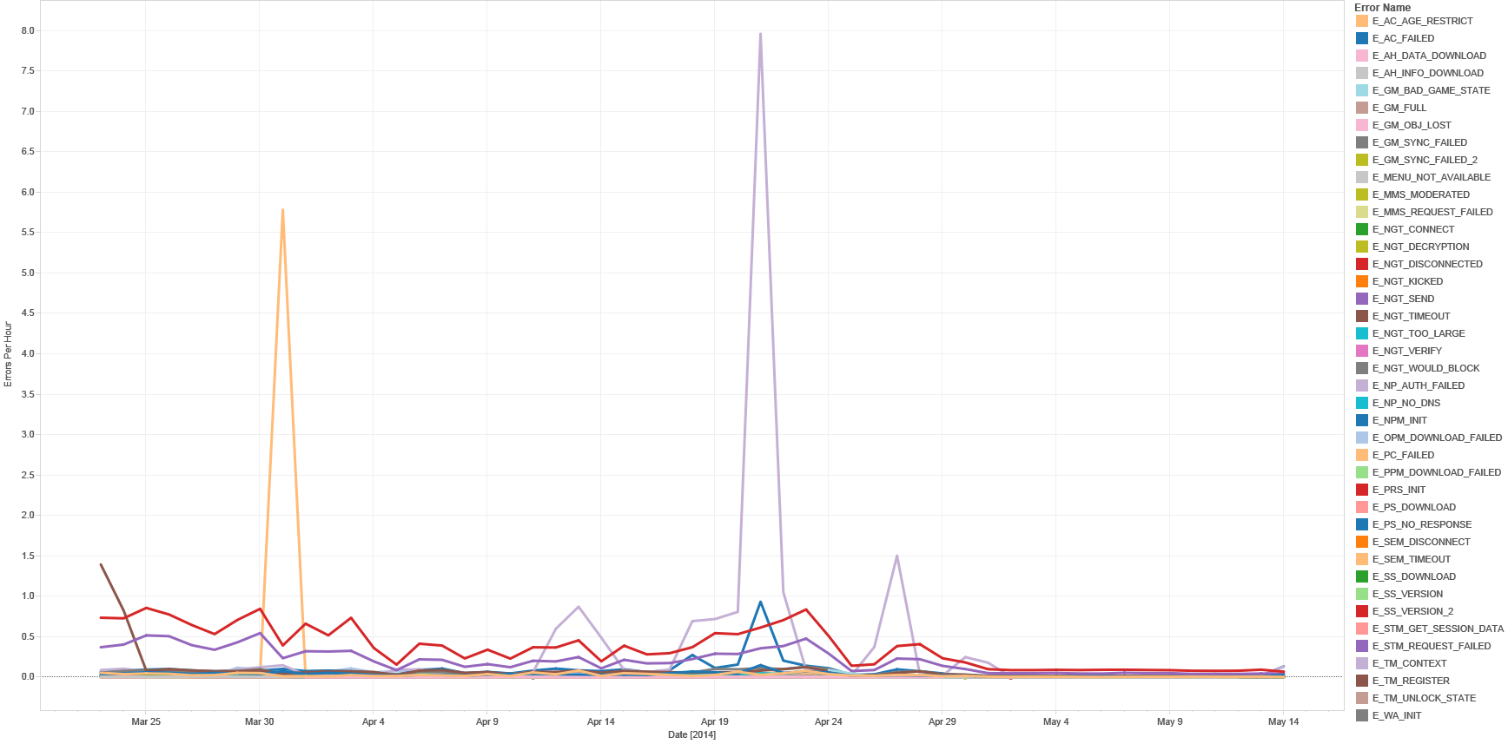
Errors Per Hour Over Time
PSNSM authentication
PlayStation®Plus check
Turbine fix
PlayStation®Plus Check = check to see if you have purchased PlayStation®Plus and can play online

Slide 49
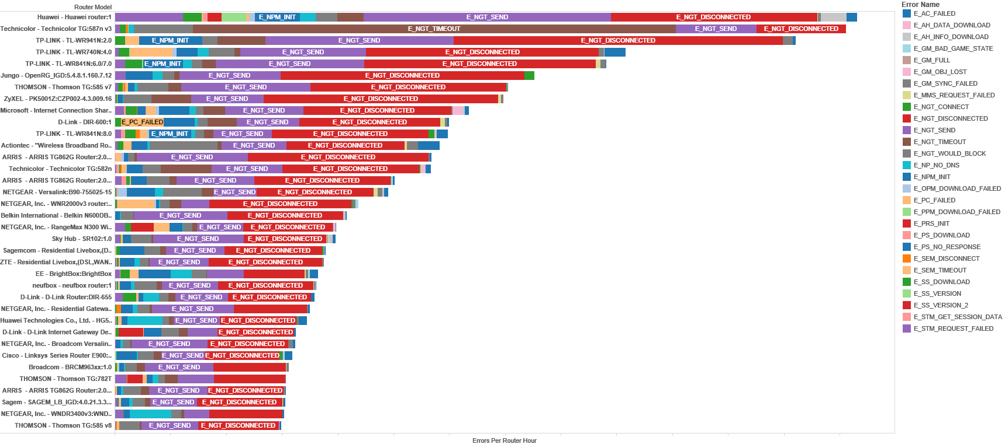
Errors Per Hour Per Router
Technicolor modem triggers
errors on round roll over

Slide 50
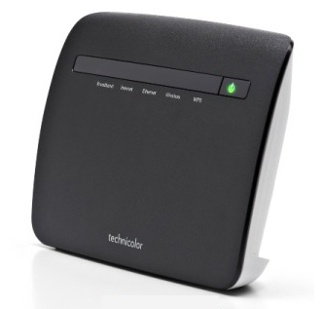
Technicolor TG587n
1 UDP socket fails to send to multiple IP’s!
Need to allocate UDP socket per IP
Server IP X.X.X.X
(first contacted)
TG587n
UDP socket
fail
Server IP Y.Y.Y.Y

Slide 51
And Then We Released Patch 1.10
Community complained about 5+ second lag
We didn’t see it, couldn’t measure it

Slide 52
Key Metric - Kill Lag
Server & client run at 60 Hz
Processing ≈ 5 * 0.5 * 1/60 ≈ 40 ms
Best ping ≈ 5 ms
PingA + PingB ≈ 10 ms
Best Kill Lag ≈ 50 ms
Consider laggy kill > 500 ms
Player A
Turbine
Player B
Fire
last
bullet
Dies
Kill Lag = Ping_{A} + Ping_{B} + Processing
Most game(r)s look at ping, ping is a bad metric!

Slide 53
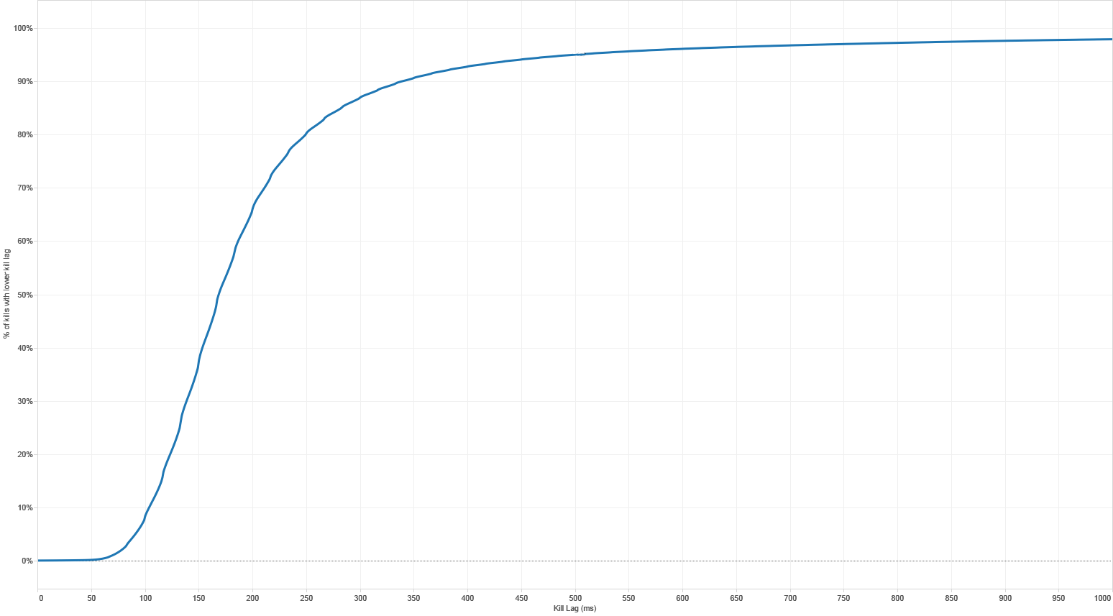
Kill Lag Measured
95% of the kills are < 500 ms.
Given measured pings, 98% is max.
Kill lag starts around 50 ms
For every kill you make we send telemetry on what the kill lag was
Graph shows percentage of kills that took lower than X-axis ms

Slide 54
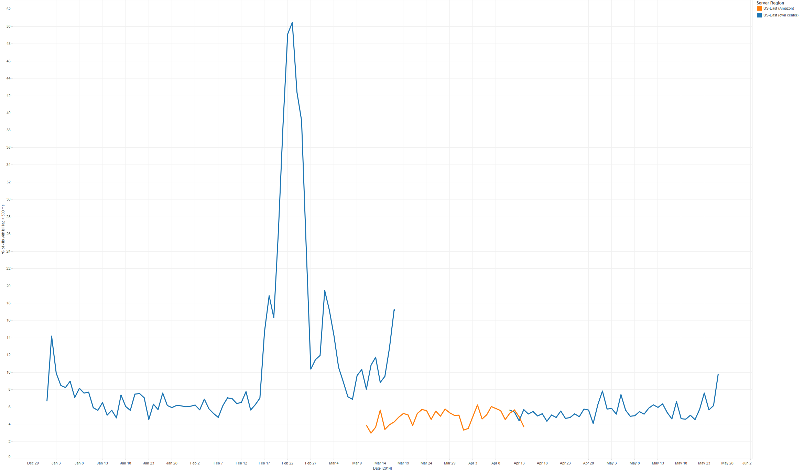
Laggy Kills Over Time
US-East gateway failure
Backup gateway high packet loss
libRUDP resend bug
libRUDP fix
Release patch 1.10
Switch to Amazon
Switch back
A/B test
Vertical axis is percentage of laggy kills
Graph shows US-East only (other regions were unaffected – which is why we didn’t see it)

Slide 55
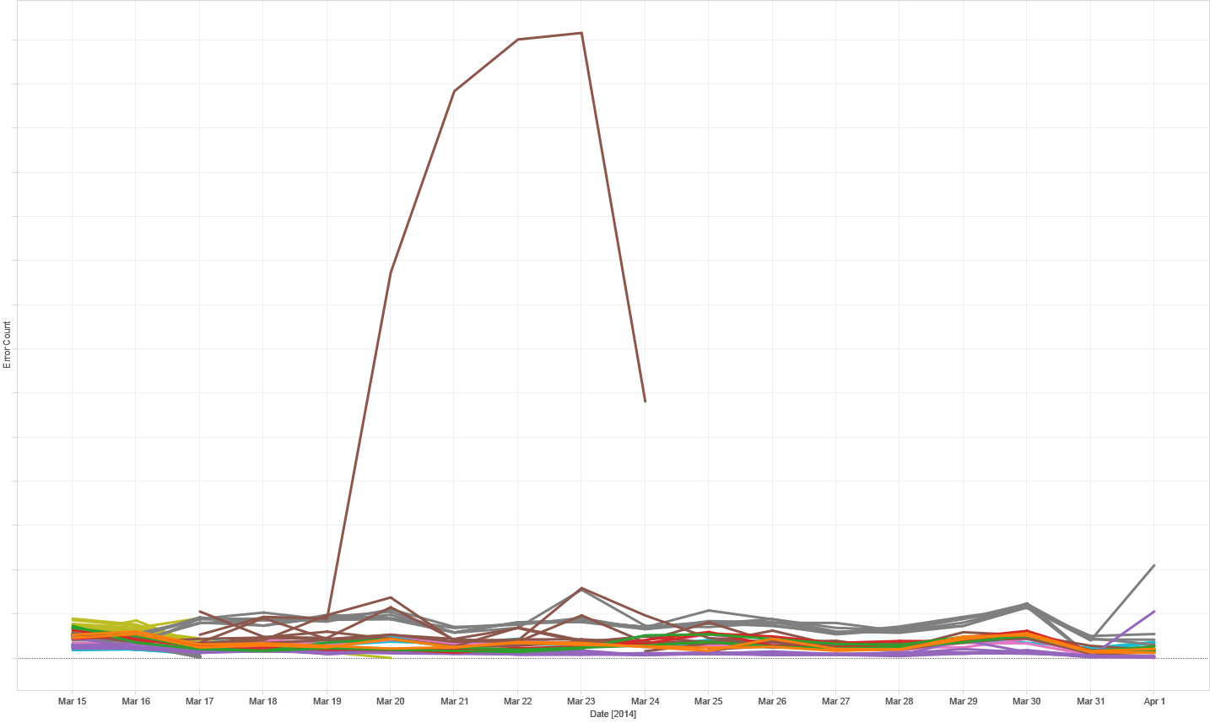
Amazon isn’t perfect either
One server triggers
a lot of network errors
Terminate, and it’s
automagically replaced
by a working instance
☺
Vertical axis shows error count per server
Color is region

Slide 56
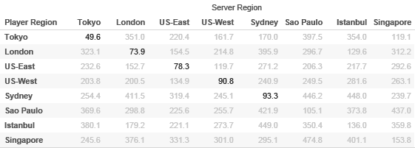
Average Ping Between Regions
No region where next closest region < 100 ms
Matchmaking tries to avoid cross region!
Smaller regions / warzones don’t have enough players
Friends may want to play cross region
98%+ success in large, 80% in smallest region
All pings > 100 ms are grey

Slide 57
Telemetry - Conclusion
You NEED telemetry to fix your game
Difficult to draw conclusions from forums
Previous examples very difficult to find
Consider key metrics
For us ‘Kill Lag’
Tie into monitoring
Monitoring = real time check that number of laggy kills stays constant, if it increases we get called

