Slide 1
Launching and Supporting Killzone Shadow Fall
Jorrit Rouwé
jorrit@guerrilla-games.com
Lead Game Tech, Guerrilla Games

Slide 2
Introduction
Killzone Shadow Fall is a First Person Shooter
24 player team based gameplay
Users can create game modes
PS4 launch title

Slide 3
Before Launch

Slide 4
Road to Launch
Previous Title: Killzone 3
Closed beta (~100 players within Sony)
Semi public beta (~15K players invited)
Public beta (~25K players concurrent)
PS4 launch
Limited hardware
Max ~100 player test
Notes:
- Previous titles had lots of issues during beta

Slide 5
Development Focus
Telemetry
Load testing
Monitoring
Kill Switches
Notes:
- No possibilities for public beta for KZSF so changed development focus

Slide 6
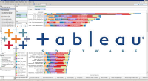
Telemetry – Collecting Game Metrics
Visualization
Storage
Game
Processing
Telemetry
Event
Collector
Redshift
Tableau
Server

Slide 7
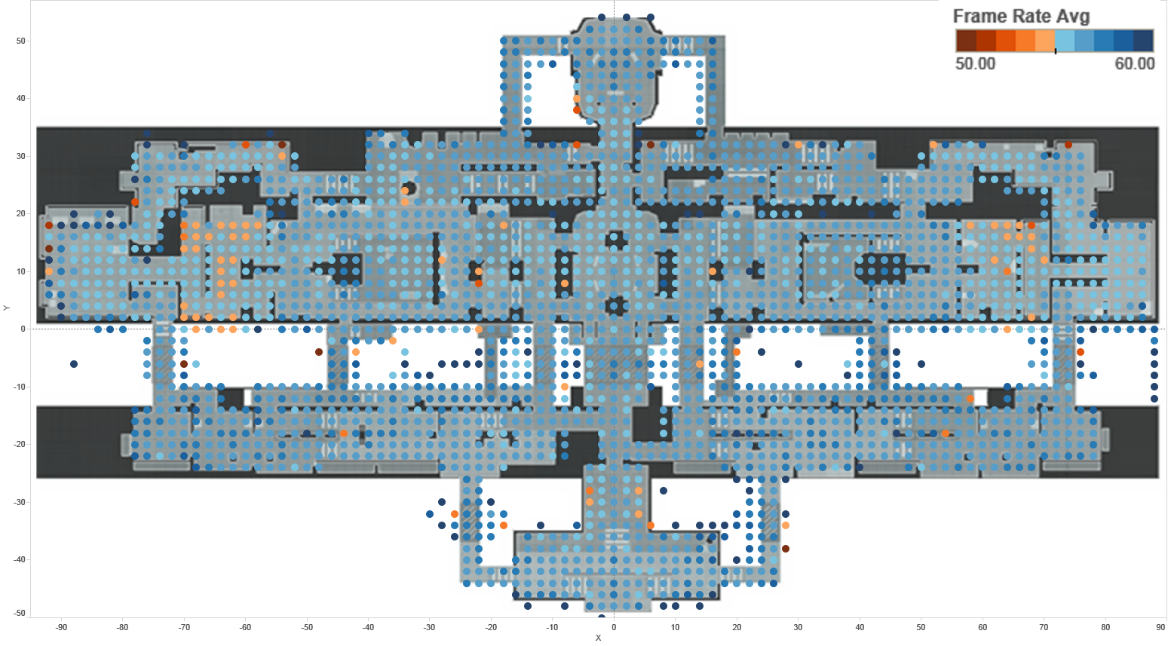
Frame Rate Heat Map – The Terminal
55 FPS: Problem area!
Notes:
- Collect data during ‘Friday Frag Fest’ (weekly event in the company to play our own game)

Slide 8
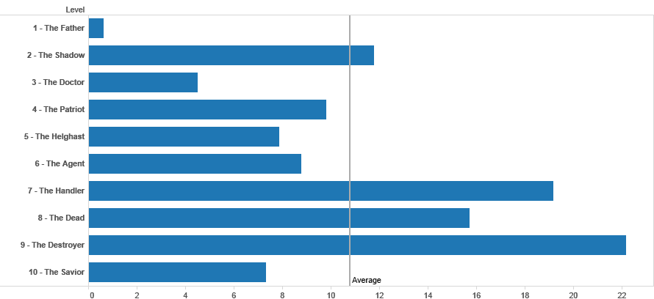
SP - Average Deaths Per Player Per Level
Notes:
- Gather data from external playtest sessions

Slide 9
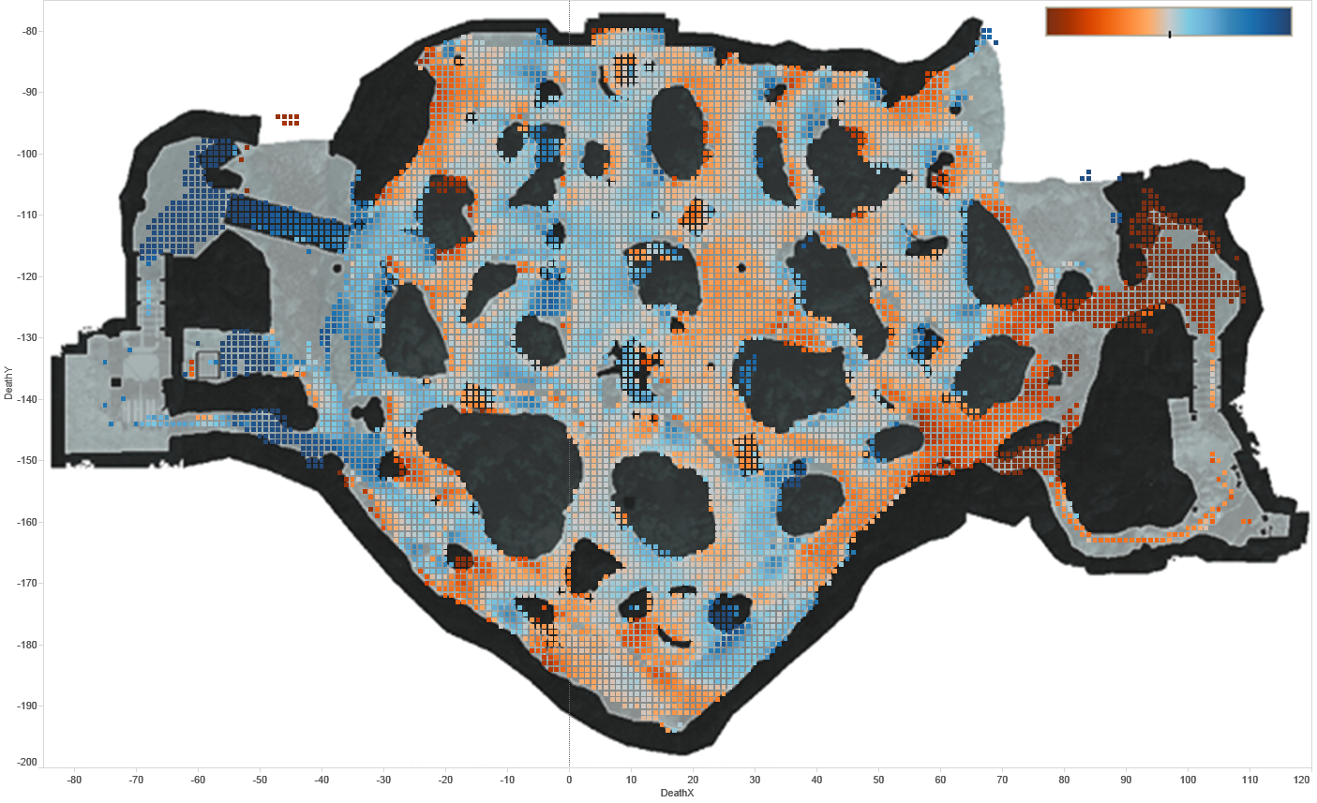
MP - Death Balance – The Forest
VSA failing to spawn camp
Objective A
100%
HGH
100%
VSA
HGH Spawn
HGH failing to spawn camp
HGH being spawn camped
VSA Spawn
Objective B
Objective C

Slide 10
Development Focus
Telemetry
Load testing
Monitoring
Kill Switches

Slide 11
Load Testing – What to Test
Functionality
Match making (e.g. day night cycle, featuring game mode)
Score posting
Leaderboards
…
Failures
Loss of server
Temporary loss of connectivity
PlayStation®Network outage / slow response
Server update

Slide 12
Load Testing – Framework
PlayStation®Network
Game Server
Sim 1..N
Sim N+1..2N
Notes:
- Load testing uses traditional approach of running multiple simulation clients on 1 server to hit the game server

Slide 13
Load Testing – Framework
Mock PlayStation®Network
Game Server
Sim 1..N
Sim N+1..2N
Notes:
- PlayStation Network doesn’t allow sign in from simulation client, so had to implement mock version

Slide 14
Load Testing – Framework
Mock PlayStation®Network
Game Server
Share state & validation
Sim 1..N
Sim N+1..2N
Notes:
- Existing web loadtesting frameworks test simple request response, match making test requires coordination between sims

Slide 15
Load Testing – Framework
Mock PlayStation®Network
Game Server
Telemetry
&
Monitoring
Behavioral
Verification
Share state & validation
Sim 1..N
Sim N+1..2N
Notes:
- Use telemetry to verify that what the client sees is the same as what the server thinks is happening

Slide 16
Development Focus
Telemetry
Load testing
Monitoring
Kill Switches

Slide 17
Monitoring
What to monitor
Player count
REST API timings / errors
Database throughput / errors
Connectivity between servers (game servers / PSN)
Low level OS (disc / CPU / memory / network)
Backups
24/7 on call support for failures

Slide 18
Development Focus
Telemetry
Load testing
Monitoring
Kill Switches

Slide 19
Kill Switches
Block apps (killzone.com, public API, live tiles)
Block individual REST APIs (e.g. post score)
Block hard to test things (e.g. game merging)
Block misc. components (e.g. telemetry)
Notes:
- If score posting API is turned off, the client will remember the score post on HDD and repost later

Slide 20
After Launch
Notes:
Launch went smooth, no major issues

Slide 21
Match Making - What Players Expect
Low ping
Full games
Team balanced
Player count
Skill level
A choice of game modes
No dropped connections
Notes:
Most complaints are about match making, covering different aspects in remainder of talk

Slide 22
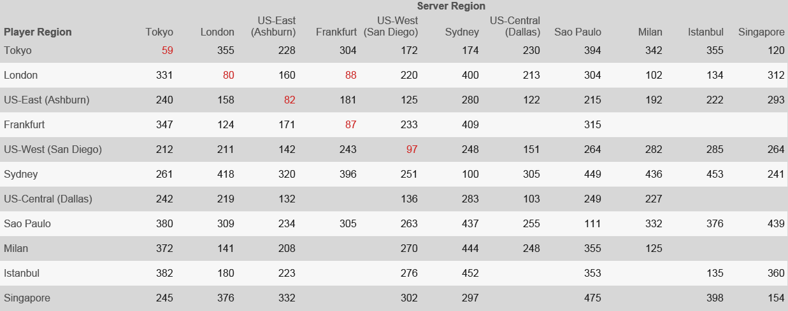
Average Ping Between Regions
Notes:
No region where next closest region < 100 ms
Except London - Frankfurt

Slide 23
Average Ping Between Regions - Conclusion
Matchmaking tries to avoid cross region!
Smaller regions / game modes don’t have enough players
Friends may want to play cross region
98%+ success in large, 80% in smallest region

Slide 24
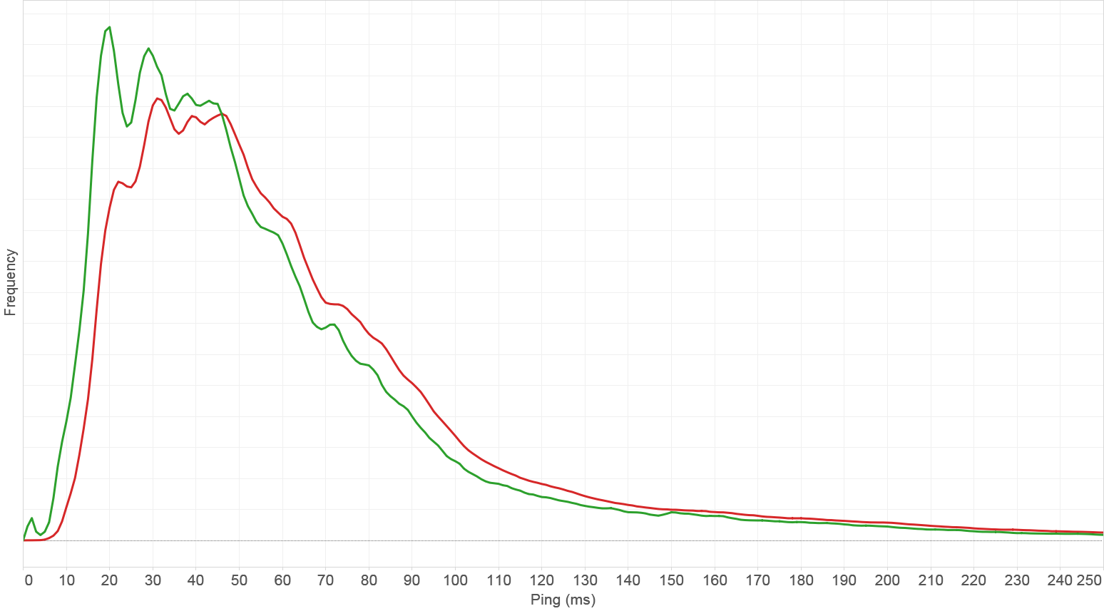
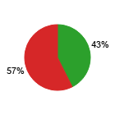
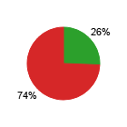
Ping – Cable vs Wireless
Play Time
Dropped connections
Wireless
Wired
Wireless ± 15 ms slower!
Educate players!

Slide 25
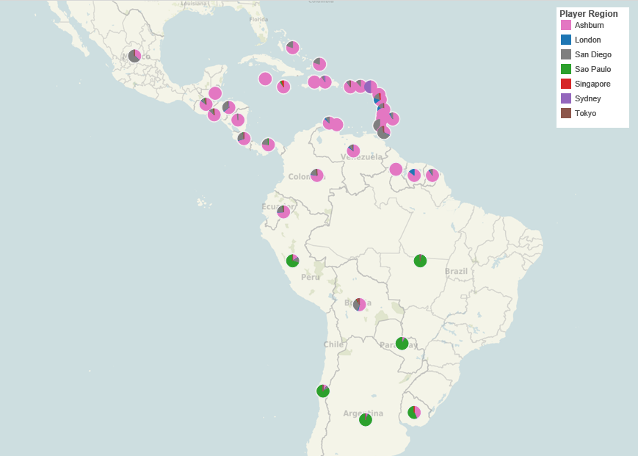
The Hunt for Server Locations (Sao Paulo)
Sao Paulo
Notes:
Initially started in
US East (Ashburn) – Sony Data Center
US West (San Diego) – Sony Data Center
EU (London) – Sony Data Center
Sydney – Amazon AWS
Singapore – Amazon AWS
Tokyo – Amazon AWS
Telemetry: Player Distribution
Determine server locations
Sao Paulo (Amazon AWS) worked for South America, Central America connects to US East even though it is closer to Sao Paolo

Slide 26
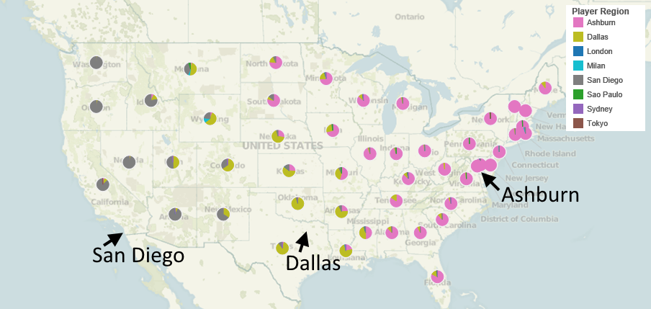
The Hunt for Server Locations (Dallas)
Notes:
- Dallas (GameServers.com) works out nicely, but we had to shut it down after player count became too low

Slide 27
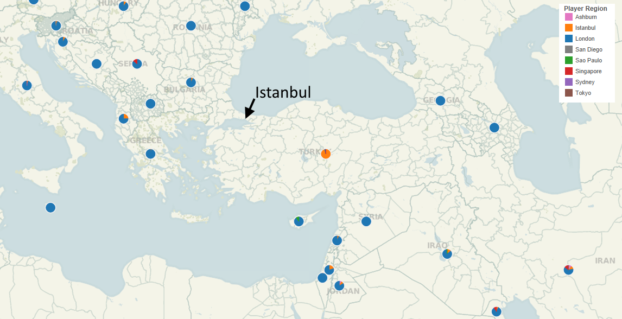
The Hunt for Server Locations (Istanbul)
Notes:
Trying to find server location for Middle East
All traffic from Istanbul (GameServers.com) to neighbouring countries via Frankfurt so London closer

Slide 28
The Hunt For Server Locations – Conclusion
Geographically close does not mean low ping
Possible packet: US East → US West → US East
Very hard for players to understand
We don’t offer region selection
Too many regions = too few players per region
Notes:
- Region selection allows players to select non-closest region and ruin the game for others

Slide 29
Match Making - What Players Expect
Low ping
Full games
Team balanced
Player count
Skill level
A choice of game modes
No dropped connections

Slide 30
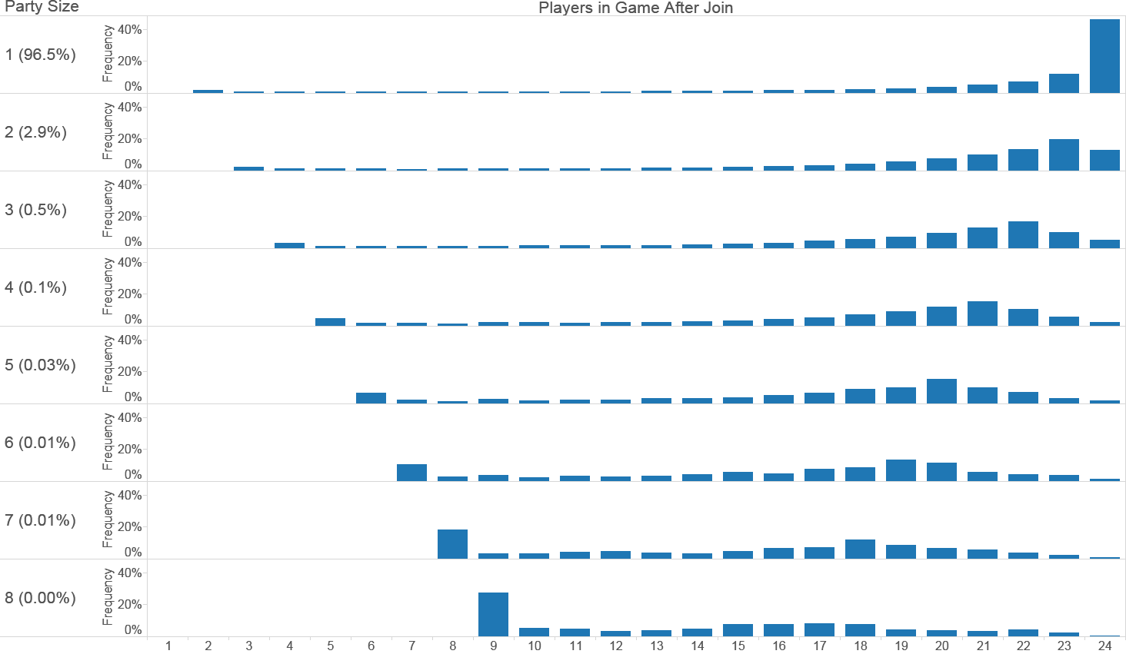
Joining Full Games
Join alone = full game
Parties of more than 2 very rare!
8 player party
→ 8 vs 1 game.
Split party?
Notes:
Matchmaking prioritizes full games
Therefore no room for parties

Slide 31
Match Making - What Players Expect
Low ping
Full games
Team balanced
Player count
Skill level
A choice of game modes
No dropped connections

Slide 32
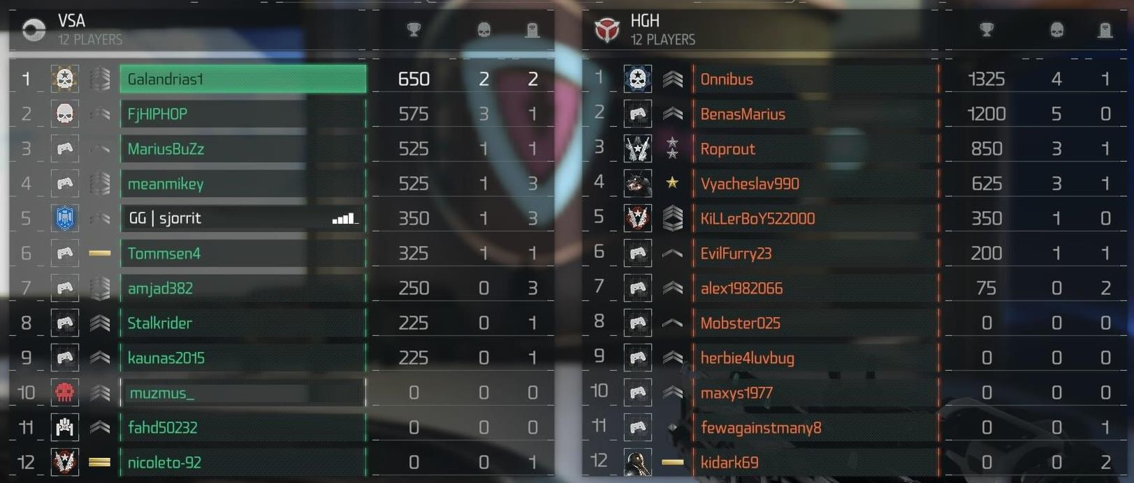
Team Balance - ELO Glicko
Divide by
time played
Discard not played long enough
Notes:
Borrowed from chess

Slide 33
Team Balance - ELO Glicko
Win
Notes:
Run 1 vs 1 chess rating calculations against each opponent

Slide 34
Team Balance - ELO Glicko
Loss
Notes:
ELO converges after ~10 games
Correlates with K/D ratio and generally seems reliable as skill metric

Slide 35
Team Balance
Skill based separation = too many groups
Player count balance most important
Use ELO skill rating to
Determine team when sizes equal
Shuffle teams at end of round
Notes:
- KZ3 showed that splitting into skill groups prevents some people from playing

Slide 36
Match Making - What Players Expect
Low ping
Full games
Team balanced
Player count
Skill level
A choice of game modes
No dropped connections

Slide 37
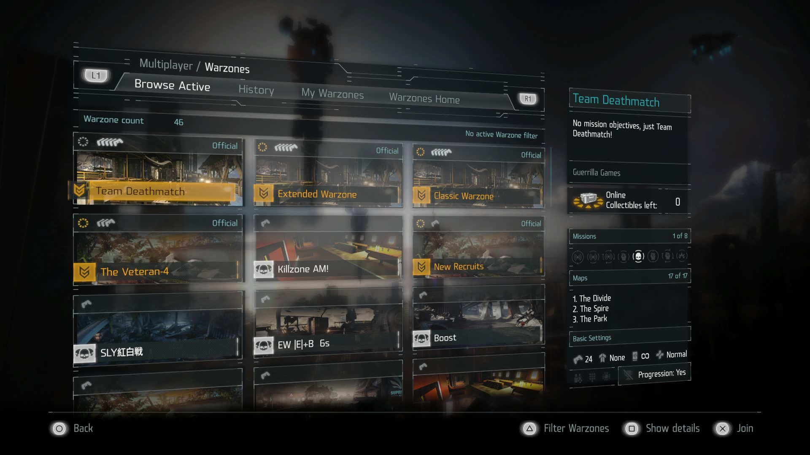
A Choice of Game Modes
Notes:
Custom game modes = many splits of community
Custom game modes very unpopular because of this
Had to reduce the amount of featured modes

Slide 38
Match Making - What Players Expect
Low ping
Full games
Team balanced
Player count
Skill level
A choice of game modes
No dropped connections

Slide 39
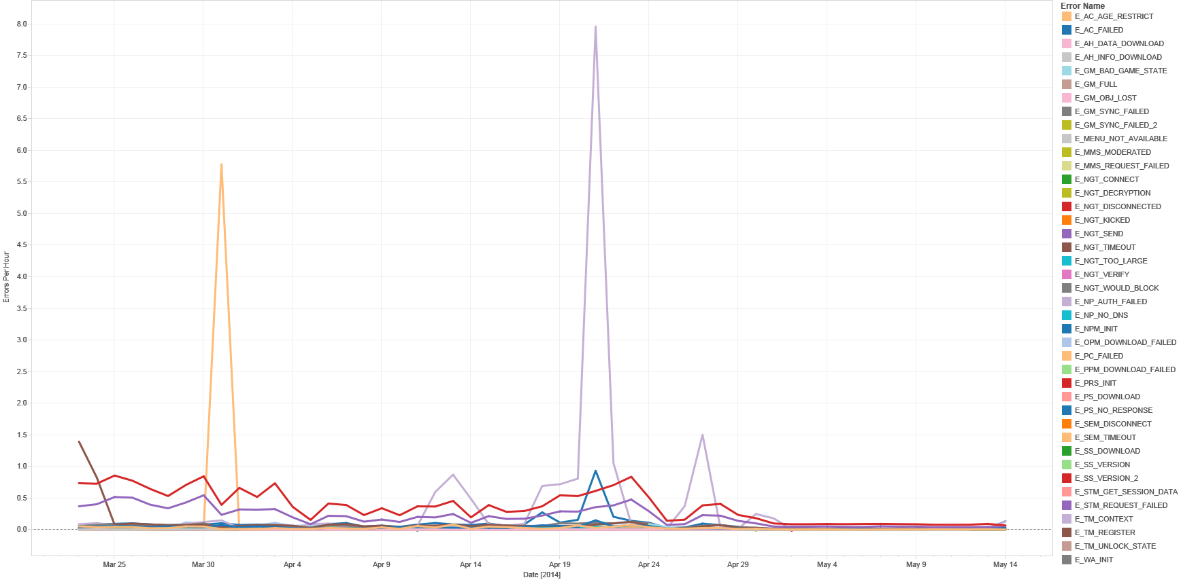
Errors Per Hour Over Time
PSN authentication
PlayStation Plus check
Buffer increase fix
(A/B test)

Slide 40
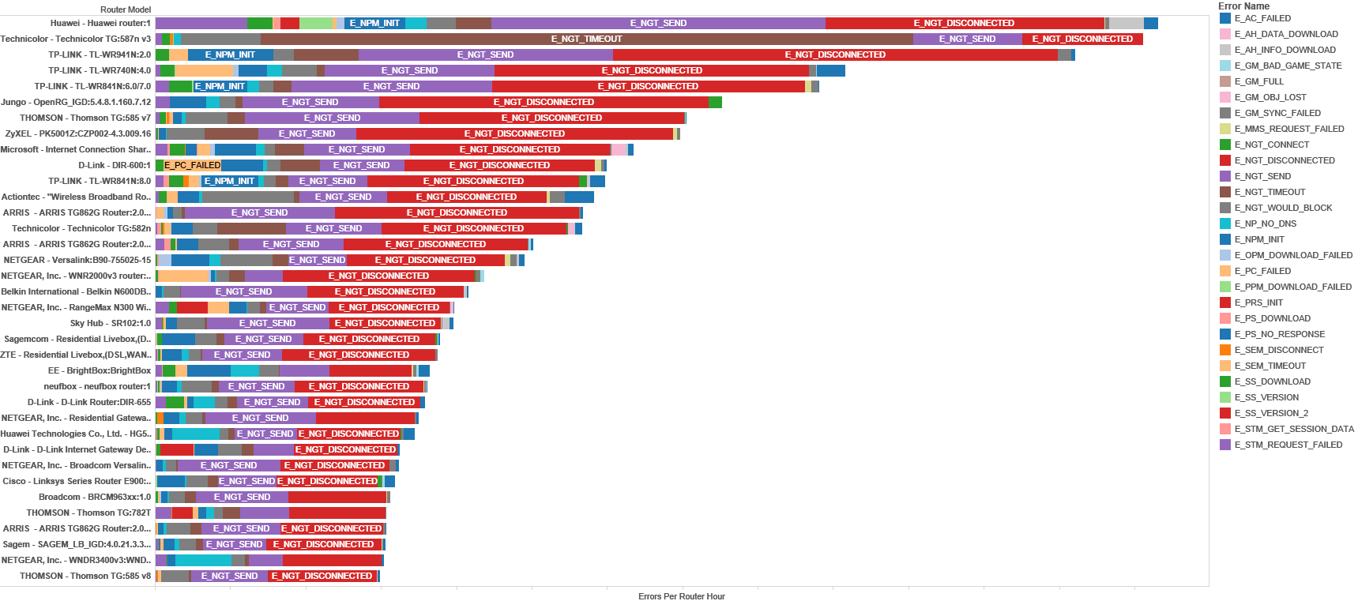
Errors Per Hour Per Router
Technicolor TG587:
UDP socket cannot connect
to multiple IP.
Notes:
- Using UPnP to gather router name

Slide 41
Conclusion
Had very little downtime
Kill switches used on few occasions
Match making is a hard problem
Telemetry helped a lot

Slide 42
Questions?
Also see: ‘The Server Architecture Behind Killzone Shadow Fall’
http://jrouwe.nl/serverarchkzsf/

Slide 43
Bonus Slides

Slide 44
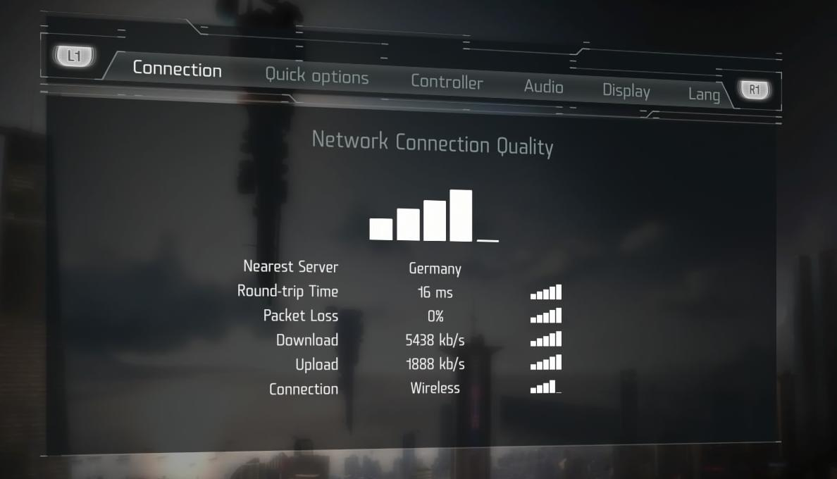
Ping – Educate Players!
Max score not possible on wireless
Notes:
Connection quality screen – allows players to inspect own connection
Wired / wireless is scored!

Slide 45
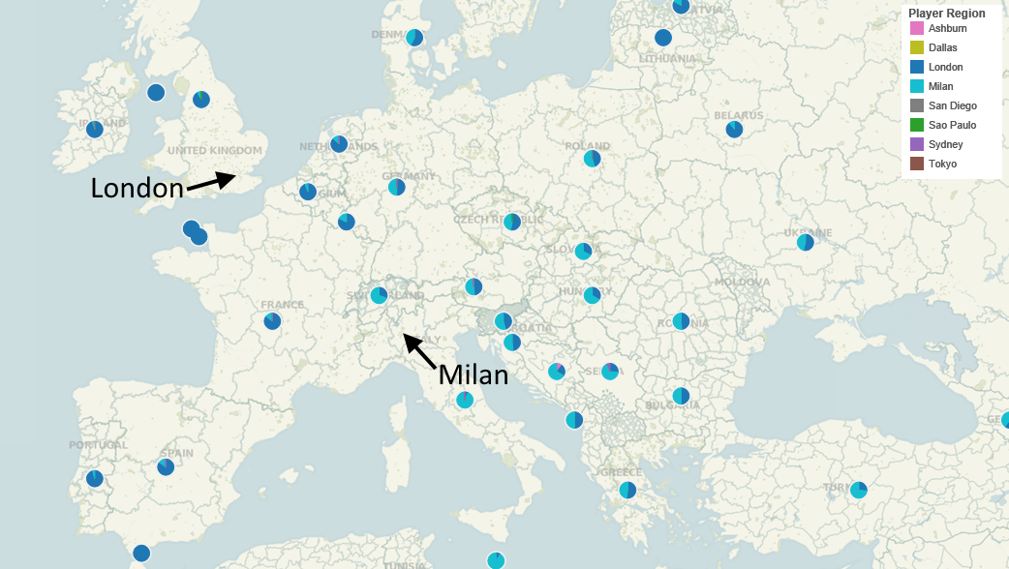
The Hunt for Server Locations (Milan)
Notes:
Tried Milan on GameServers.com
Lower ping for South Europe
Connection was unstable (lag spikes) so terminated

Slide 46
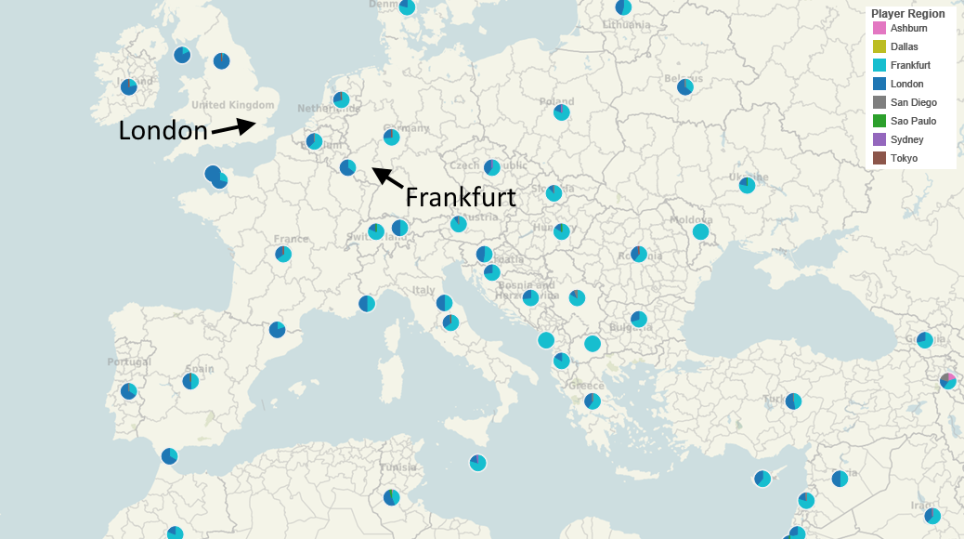
The Hunt for Server Locations (Frankfurt)
Notes:
Amazon AWS in Frankfurt
Provides better latency for South Europe, slightly worse in North Europe
Terminated London in favor of Frankfurt to keep enough players in one server

