Slide 1
Killzone Shadow Fall: Threading the Entity Update on PS4 Jorrit Rouwé Lead Game Tech, Guerrilla Games

Slide 2
Introduction
Killzone Shadow Fall is a First Person Shooter
PlayStation 4 launch title
In SP up to 60 characters @ 30 FPS
In MP up to 24 players @ 60 FPS
Gameplay logic has lots of
Branches
Virtual functions
Cache misses
Not suitable for PS3 SPU’s but PS4 has 6 x86 cores

Slide 3
What do we cover?
What is an Entity?
What we did on PS3
Multi threading on PS4
Balancing Entities across frames
Performance issues found
Performance results achieved
Debug tools

Slide 4
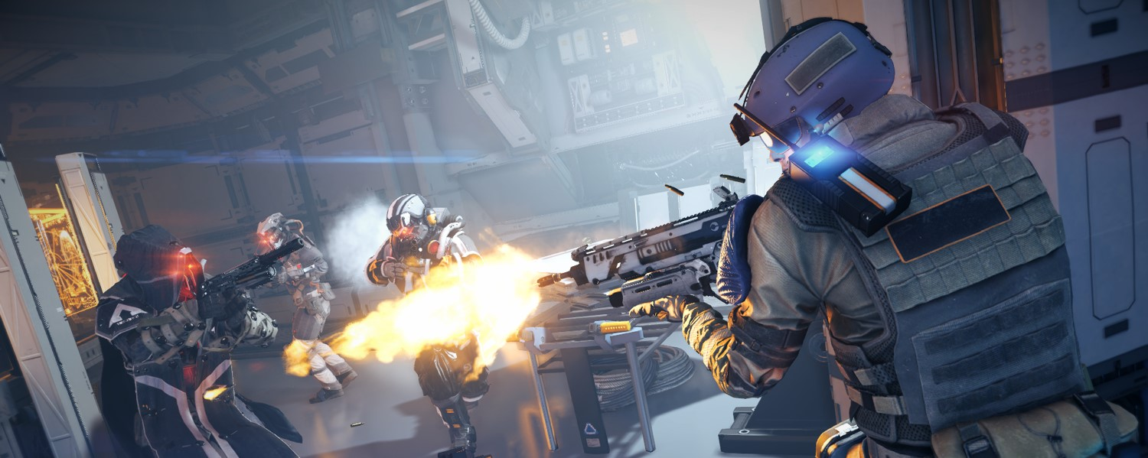
What is an Entity?

Slide 5
What is an Entity?
Base class for most game objects
E.g. Player, Enemy, Weapon, Door
Not used for static world
Has Components
E.g. Model, Mover, Destructibility
Update at a fixed frequency
15, 30, 60 Hz
Almost everything at 15 Hz
Player updated at higher frequency to avoid lag

Slide 6
What is a Representation?
Entities and Components have Representation
Controls rendering, audio and VFX
State is interpolated in frames where entity not updated
Cheaper to interpolate than to update
Introduces latency
Always blend towards last update

Slide 7
Notes:
Game in slow motion
Watch visual mesh (representation state) lag behind white skeleton (entity state)
Mention this is the player model but forced to run at 15 Hz

Slide 8
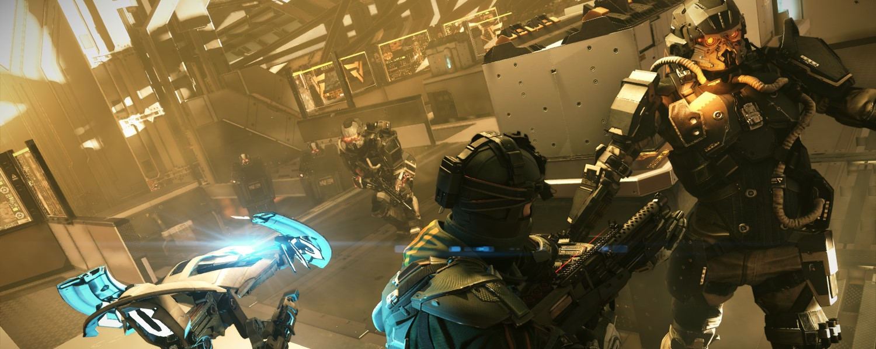
Multi Threading Approach

Slide 9
PS3: 1 Entity = 1 Fiber
yield fiber
resume fiber
PPU
Entity 1
Entity 2
Entity 3
Entity 1
Entity 2
SPU 1
Animation
SPU 2
Ray Cast
Time
Most time spent on PPU
No clear concurrency model
Read partial updated state
Entities deadlock waiting for each other

Slide 10
PS4: 1 Entity = 1 Job
job
CPU 1
Entity 1
Animation
Entity 1
☺
CPU 2
Entity 2
Ray Cast
Entity 2
CPU 3
Entity 3
Time
No fibers
Entity updates as a whole
How to solve race conditions?
Notes:
Explain quickly that we considered other approaches too

Slide 11
Strong Dependencies
Make update order explicit:
Soldier
strong
dependency
Missile Launcher
Soldier
Missile Launcher
Missile
Time
Missile

Slide 12
Non-dependent Entities can Execute Concurrently
Soldier1
Soldier2
Soldier1
Weapon1
CPU 1
CPU 2
Soldier2
Weapon2
Weapon1
Weapon2
Time
No (indirect) dependency = no access
Works two ways: Weapon can access Soldier too
Create dependency has 1 frame latency
Global systems need locks

Slide 13
What about this?
Soldier1
Soldier2
Pistol1
Pistol2
Bullet System
Soldier1
Pistol1
Soldier2
Pistol2
Bullet System
Time
A few entities cause huge bottleneck

Slide 14
Non-exclusive Dependencies
Soldier1
Soldier2
CPU 1
Soldier1
Pistol1
Bullet System
Pistol1
Pistol2
CPU 2
Soldier2
Pistol2
non-exclusive
Time
Barrier
Bullet System
Access to ‘Bullet System’ must be lock protected

Slide 15
Weak Dependencies
2 tanks fire at each other:
Update order reversed when circular dependency occurs
Not used very often (< 10 per frame)
Tank1
Tank2
Tank1
Missile1
Tank2
Missile2
weak
strong
or
Tank2
Missile2
Tank1
Missile1
Missile1
Missile2
Time

Slide 16
Non-updating Entities
Entity can skip updates (LOD)
Entity can update in other frame
Do normal scheduling!
Entity1
not updating
Entity2
Entity1
Entity3
Time
Entity3

Slide 17
Summarizing Dependencies
 | Strong Exclusive | Weak Exclusive | Strong Non-excl. | Weak Non-excl.
Symbol
Two way access | ✓ | ✓ | ✓ | ✓
Order guaranteed | ✓ |  | ✓
Allow concurrency | + | + | ++ | ++
Require lock |  |  | ✓ | ✓

Slide 18
Referencing Entities
Dev build: CheckedPtr<Entity>
Acts as normal pointer
Check dependency on dereference
Retail build: Entity *
No overhead!
Doesn’t catch everything
Can use pointers to members
Bugs were easy to find

Slide 19
Working with Entities without dependency
ThreadSafeEntityInterface
Mostly read only
Often used state (name, type, position, …)
Mutex per Entity
Send message (expensive)
Processed single threaded when no dependency
Schedule single threaded callback (expensive)
Everything can be accessed

Slide 20
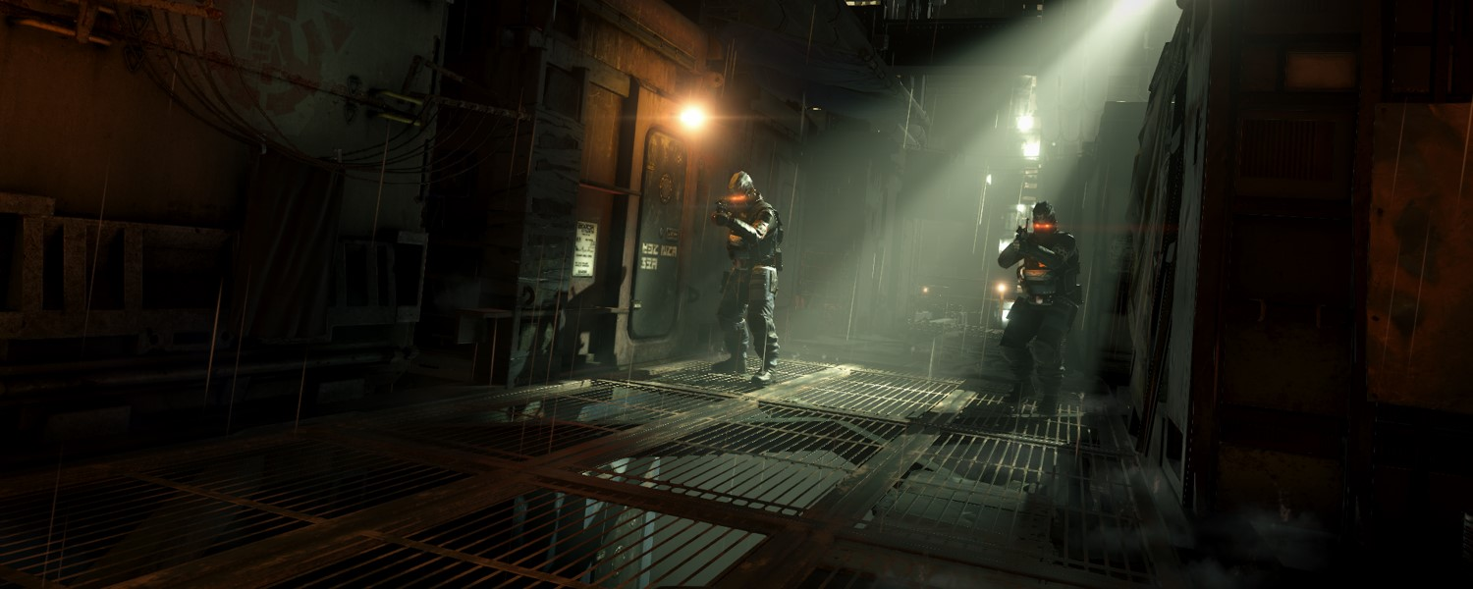
Scheduling Algorithm

Slide 21
Scheduling Algorithm
Soldier
strong
Job1
not updating
Soldier
Missile
Tank
Pistol
Missile Launcher
Pistol
non-exclusive
job dependency
Missile
Bullet System
Job2
weak
Bullet System
Tank
Entities with exclusive dependencies merged to 1 job
Dependencies determine sorting
Non-exclusive dependencies become job dependencies
Expensive jobs kicked first!
Notes:
- Mention that Missile Launcher and Pistol cannot execute concurrently because they both may touch the Soldier

Slide 22
Scheduling Algorithm – Edge Case
Job1
Entity1
Entity3
Entity1
Entity2
non-exclusive
Job1
exclusive
job dependency
Entity1
Entity3
Entity2
Entity4
Entity2
Entity4
Job2
Entity3
Entity4
Non cyclic dependency becomes cyclic job dependency
Job1 and Job2 need to be merged

Slide 23
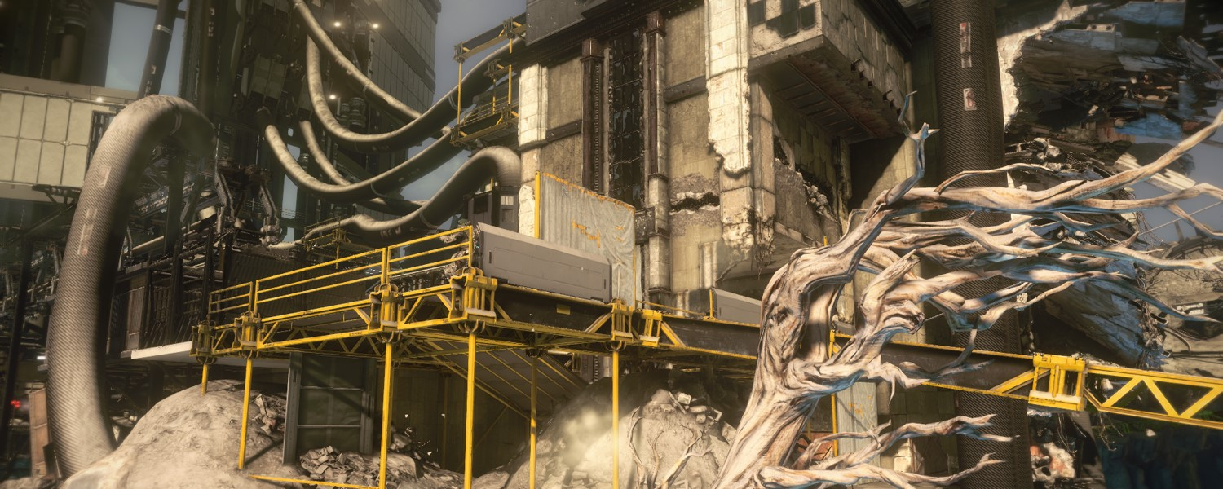
Balancing Entities Across Frames
Notes:
- Mention this is a side track

Slide 24
Balancing Entities Across Frames
Prevent all 15 Hz entities from updating in same frame
Entity can move to other frame
Smaller delta time for 1 update
Keep parent-child linked entities together
Weapon of soldier
Soldier on mounted gun
Locked close combat

Slide 25
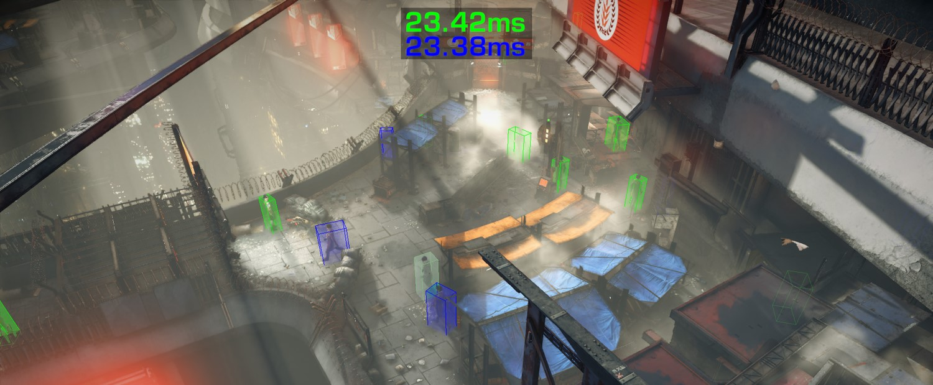
Balancing Entities – In Action
Time in even frame
(sum across cores, running average)
Time in odd frame
(should be equal)
Civilian @ 15Hz
update even frame
Civilian @ 15Hz
update odd frame
Flash on switch odd / even
Notes:
First we will add entities (both blue and green entities spawned, watch counters increase)
Then we will remove blue entitiex 2x (watch counters decrease, but quickly rebalance)

Slide 27
Notes:
Game in slow motion
When box color changes entity is moved to other frame
Watch green boxes update 2x in quick succession to compensate

Slide 28
Performance Issues

Slide 29
Performance Issues
Memory allocation mutex
Eliminated many dynamic allocations
Use stack allocator
Locking physics world
R/W mutex for main simulation world
Second ‘bullet collision’ broadphase + lock
Large groups of dependent entities
Player update very expensive

Slide 30
Cut Scene - Problem
Cut Scene
Civilian 1
Civilian 2
Player
Camera
Cut scene entity requires dependencies
10+ characters in cut scene creates huge job!

Slide 31
Cut Scene - Solution
Cut Scene
non-exclusive
Sub Cut Scene 1
Sub Cut Scene 2
Sub Cut Scene 3
Civilian 1
Civilian 2
Player
Camera
Create sub cut scenes for non-interacting entities
Master cut scene determines time and flow
Scan 1 frame ahead in timeline to create dependency
Notes:
- Mention that jump event pauses sequence for 1 frame

Slide 32
Using an Object
Dependencies on useable objects not possible (too many)
Get list of usable objects
Global system protected by lock
‘Use’ icon appears on screen
Player selects
Create dependency
Start ‘use’ animation
Start interaction 1 frame later (dependency valid)
Hides 1 frame delay!

Slide 33
Grenade
Explosion damages many entities
Creating dependencies not option (too many)
ThreadSafeEntityInterface not an option
Need knowledge of parts
Run line of sight checks inside update
Uses scheduled callback to apply damage

Slide 34
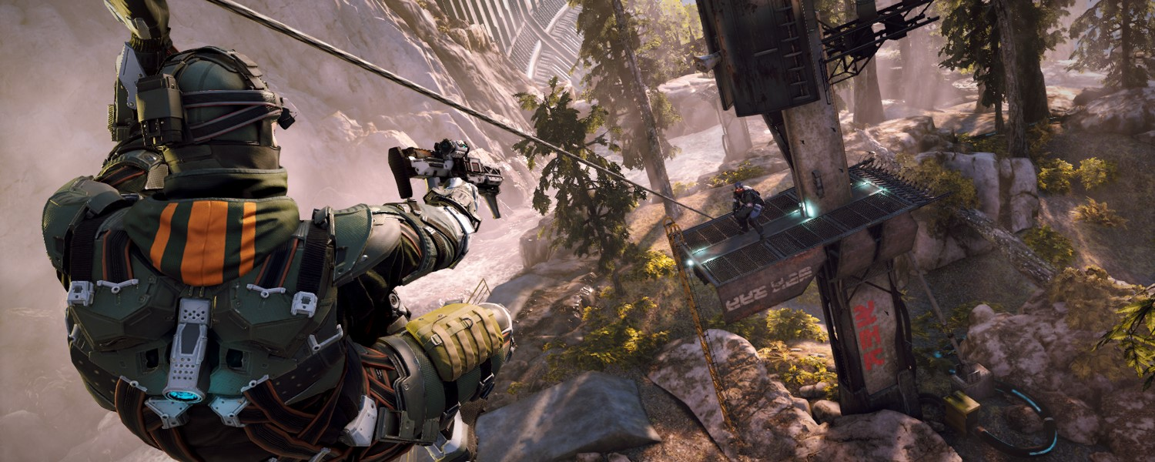
Performance Results

Slide 35
Performance Results - Synthetic
Level | Counts |  |  | Dependencies |  | Max Entities in Job | Speedup
 | Number Entities | Updating Entities | Number Humans | Strong Excl | Strong Non-Excl
5000 Crates (20 µs each) | 5019 | 5008 | 1 | 12 | 4 | 13 | 2.8X
100 Soldiers (700 µs each) | 326 | 214 | 105 | 212 | 204 | 19 | 4.2X
500 Flags (160 µs each) | 519 | 508 | 1 | 12 | 4 | 13 | 5.2X
6 cores!
5000 Crates
100 Soldiers
500 Flags

Slide 36
Performance Results - Levels
Level | Counts |  |  | Dependencies |  | Max Entities in Job | Speedup
 | Number Entities | Updating Entities | Number Humans | Strong Excl | Strong Non-Excl
The Helghast (You Owe Me) | 1141 | 206 | 32 | 71 | 23 | 20 | 4.1X
The Patriot (On Vectan Soil) | 435 | 257 | 44 | 199 | 107 | 15 | 4.3X
The Remains (12p Botzone) | 450 | 128 | 14 | 97 | 44 | 18 | 3.7X
The Helghast
The Patriot
The Remains

Slide 37
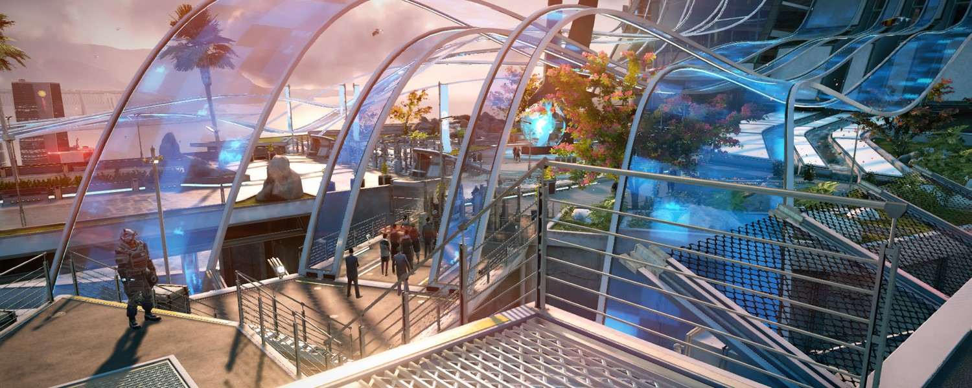
Game Frame - The Patriot

Slide 38
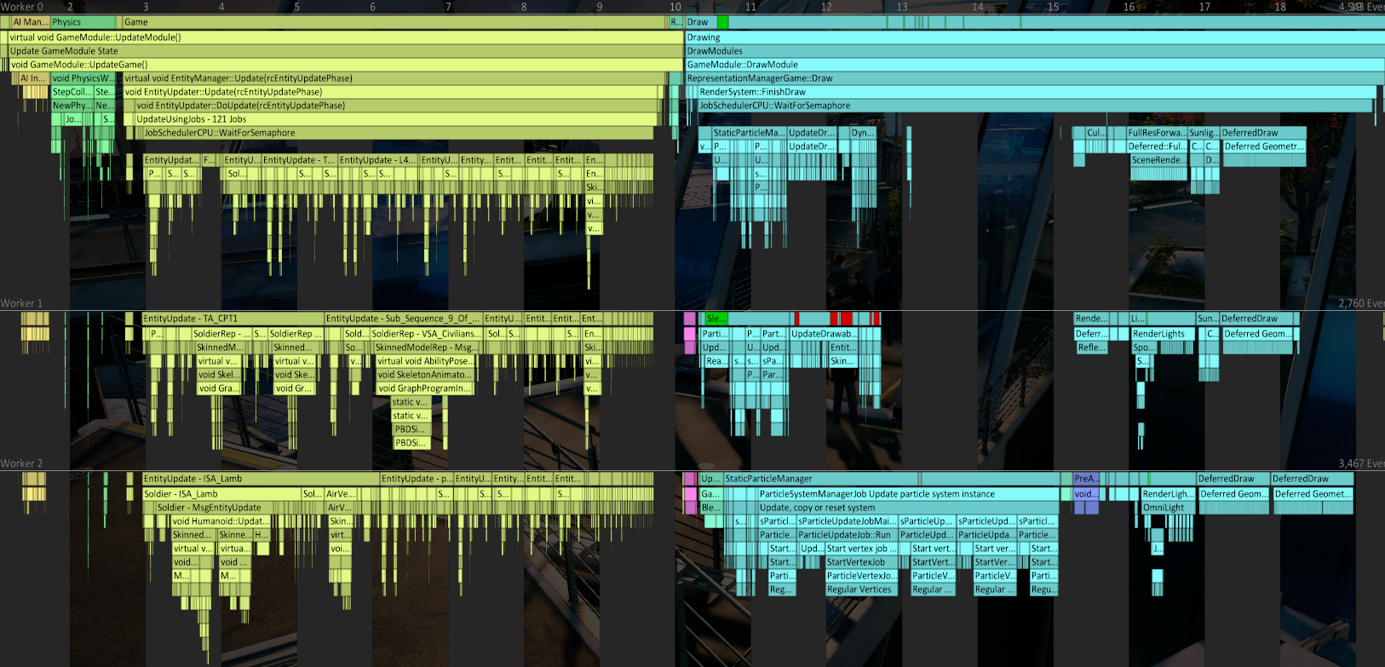
Game Frame - Global
CPU 1 (main thread)
AI
VFX & Draw
Physics
Entity Update
CPU 2
CPU 3
Time
Barrier
18 ms
Notes:
- Mention that other 3 CPUs don’t fit on screen

Slide 39
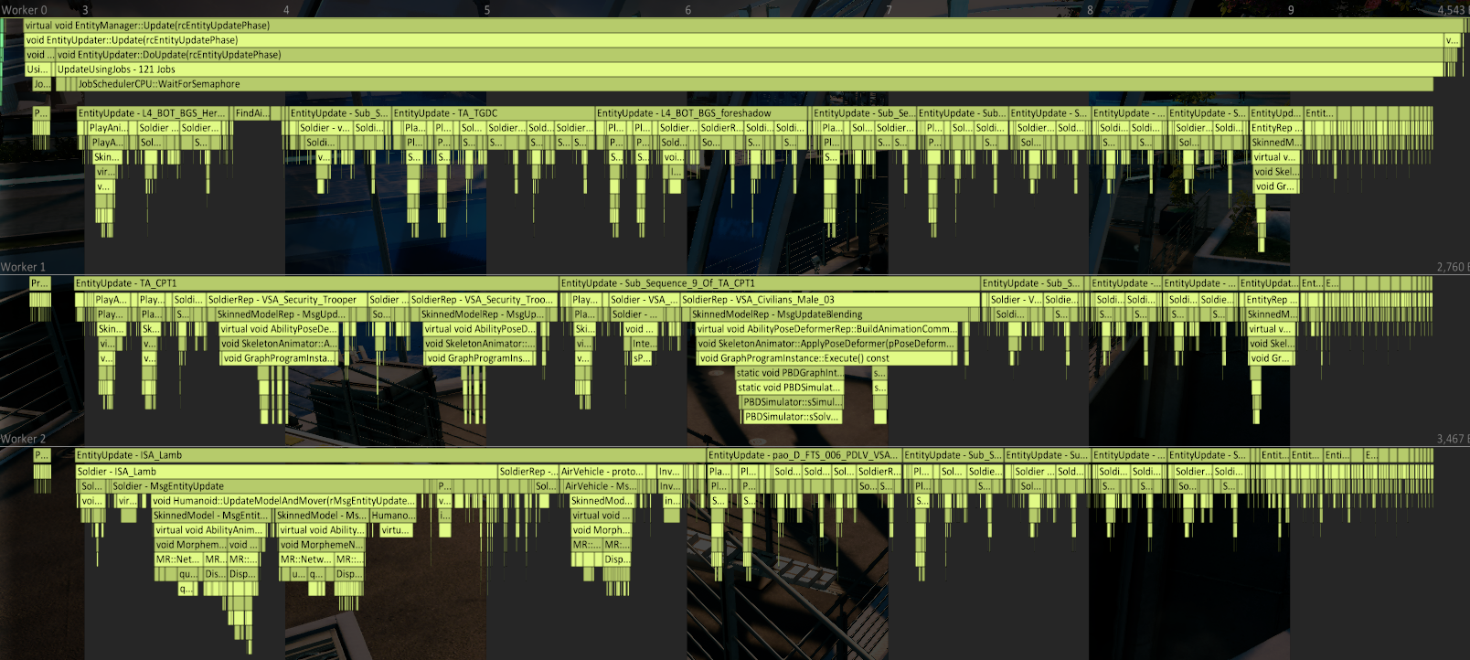
Game Frame – Entity Update
Single Threaded Callbacks
Fix Weak Dependency Cycles
Prepare Jobs
Link and Order Jobs
Execute Jobs
Cut Scene
Cheap Entities (Destructibles)
Sub Cut Scenes
AI Soldier
Cloth Simulation
Player Job
Player Representation
Player Entity
OWL (Helper Robot)
Inventory
Animation
Capsule Collision

Slide 40
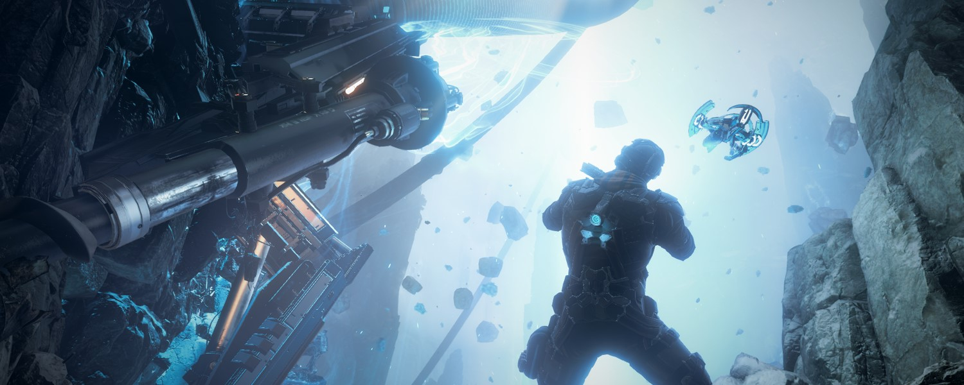
Debug Tools

Slide 41
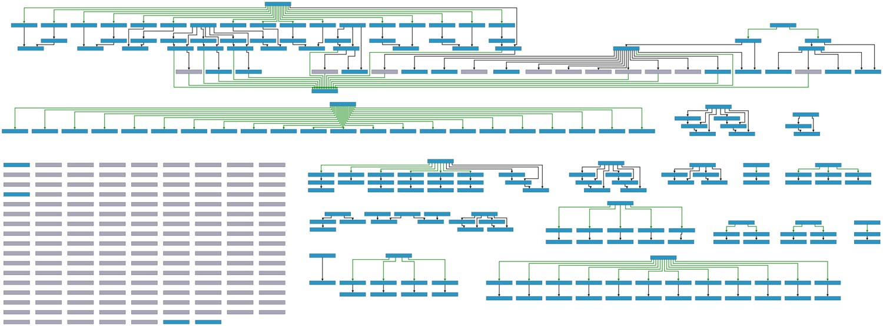
Debug Tools
Cut scenes
Player
Bullet System
Dependencies get complex, we use yEd to visualize!

Slide 42
Conclusions
Easy to implement in existing engine
Game programmers can program as if single threaded
Very few multithreading issues

Slide 43
Questions?
jorrit@guerrilla-games.com

